Slide 1



Design Thinking By AI
Surawich Aungsusink 6310422083

Slide 2
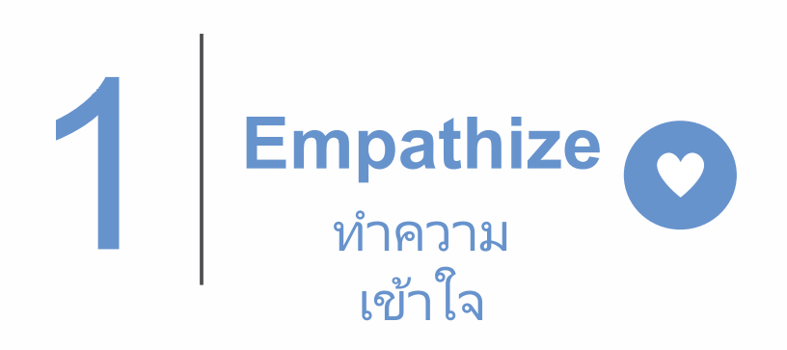

Slide 3
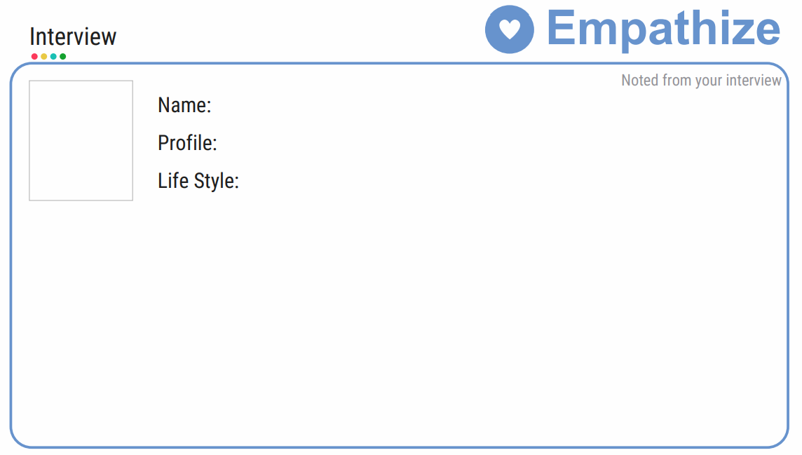
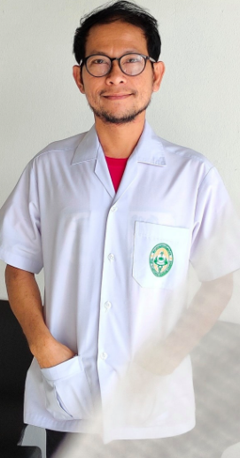
Autwachi
Thai Traditional Doctor
Trekking, Colleting Herbs and Compouding Medecine

Slide 4
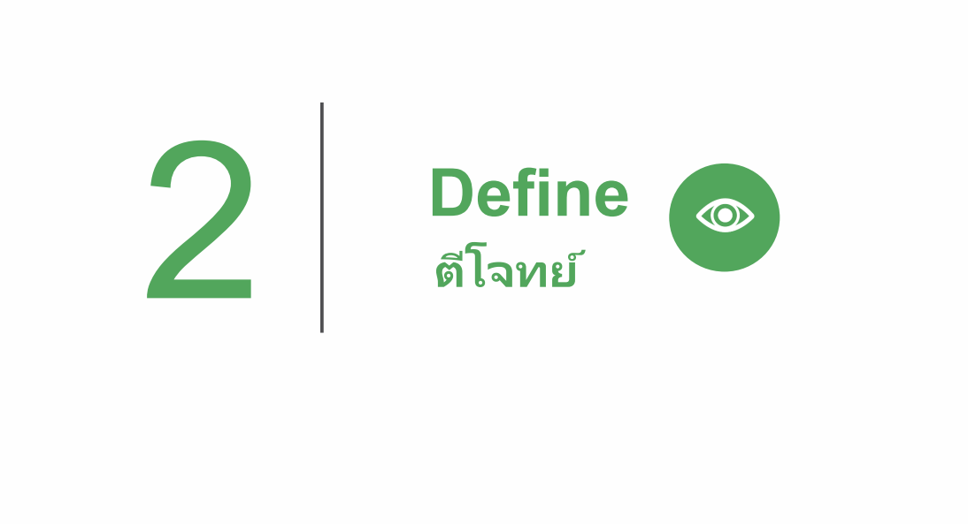

Slide 5
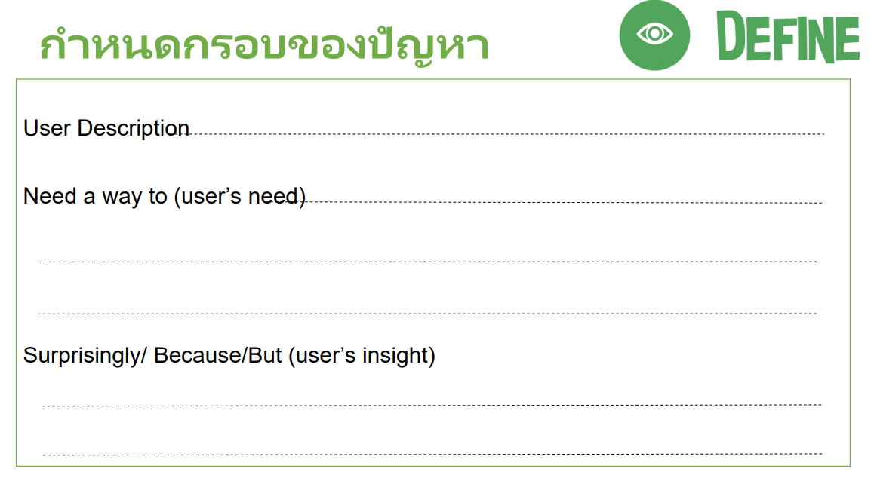
Autwachi is a Thai Traditional Doctor who working in almost very day in Chanthaburi.
Autwachi needs to verify plant morphology before collecting herbs
and compounding medicine for patient.
It is normally difficult to visual check a different type of herb leaves as herb must be always collected in the
morning time. He rarely meets the target because of time constraint.

Slide 6


Slide 7
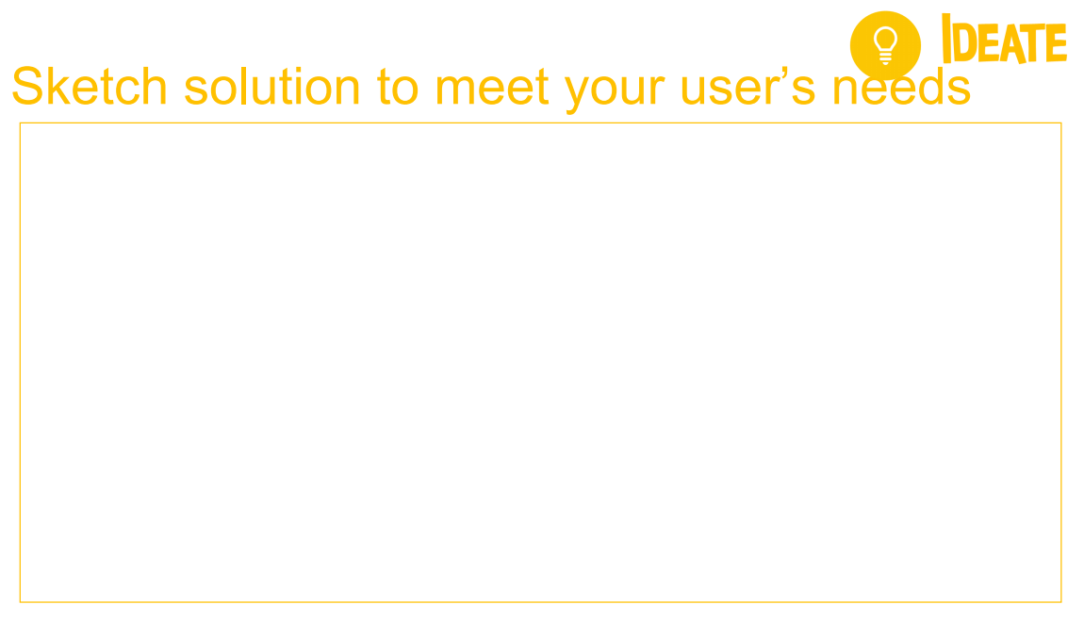
Plant herbs in the garden nearby his home.
Hire more people to collect herb and train them to check herb leaves from photograph.
Use drone to find out most possible area for collecting herbs.
Use google map for faster trekking.
Use robot to help collecting herbs.
Use AI and image processing to identify plant morphology.
… etc

Slide 8
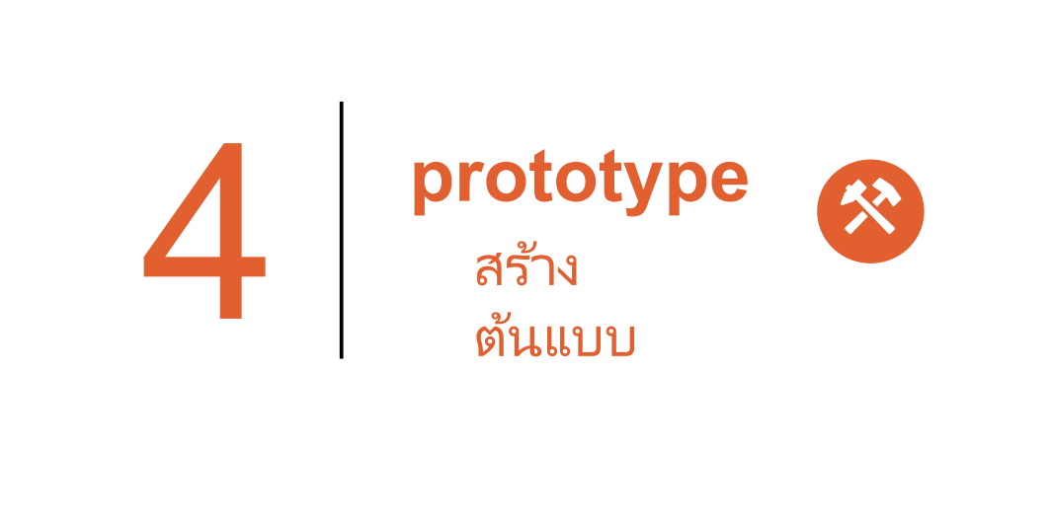

Slide 9
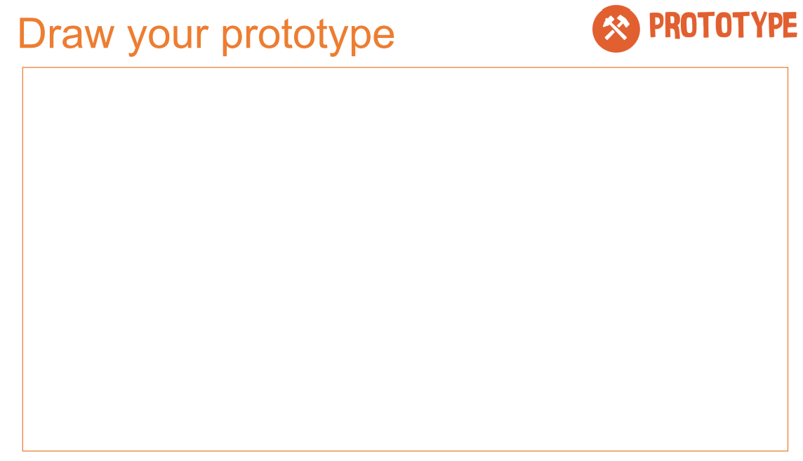
Use AI and image processing to identify plant morphology.
1.
Collect herbs leave
2.
Clean, Prepare and Manipulate Data
3.
Train Model
4.
Test Data
7.
Deploy AI Model with google firebase, Arduino IDE and ESP32 board.
5.
Accurate
?
Yes
No
6.
Improve

Slide 10


Slide 11
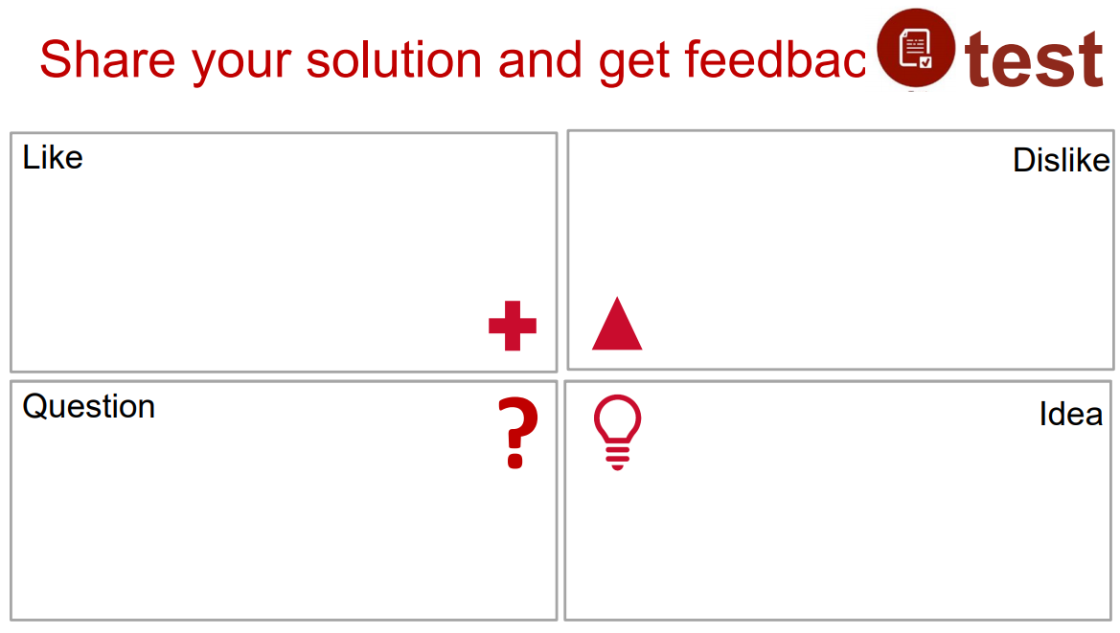
Feels more comfortable to have supporter.
Feels happy to save time for identify herb leaves.
Feels too expensive to invest in new technology.
Does not want to trust 100 percent in AI.
How can to take picture for all herb leaves ?
How can AI detect the right herb leaves ?
Is there any ways to buy a cheaper camera and a cloud database ?
How can real time connect ESP232 / Arduino IDE board (IOT equipment) with cloud database to detect herb leaves image ?
Gradually download the target herb leaves from internet as initial train data.
The more training data and testing data with good technique such as CNN, ConvNet or GoogLeNet can enhance the better detection.
Use 12 month-free trial cloud database at the initial state such as Huawei Cloud.
Use LORA WAN to connect IOT equipment with cloud database.

Slide 12
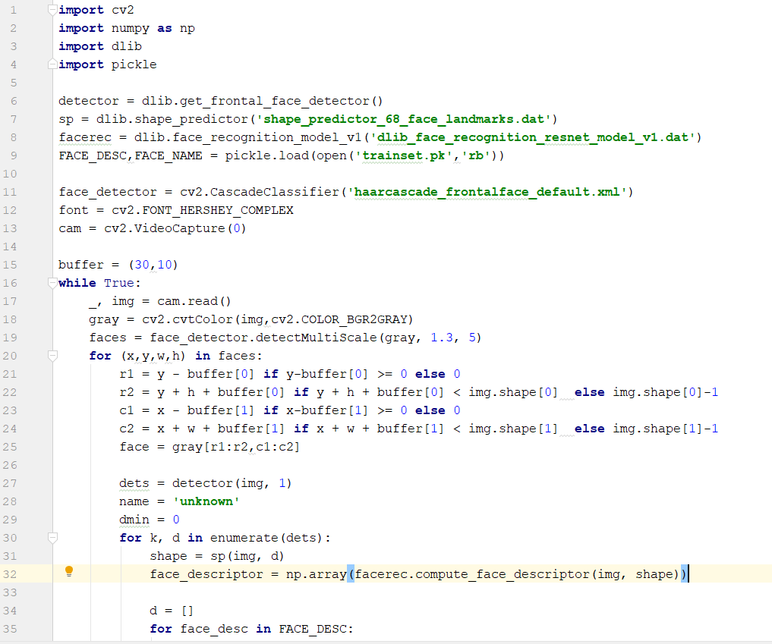
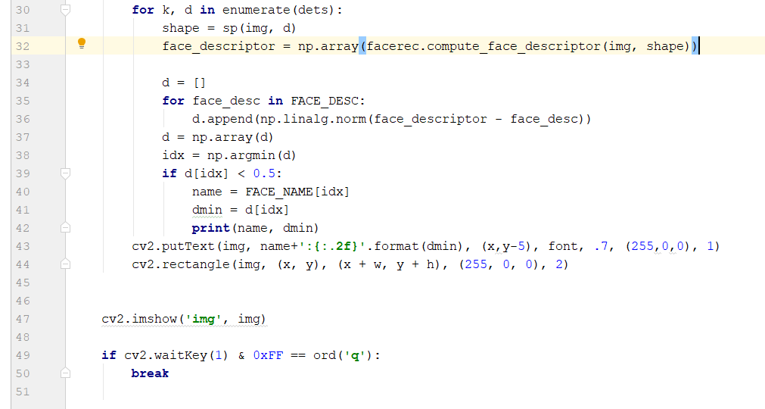
Appendix I – app.py

Slide 13
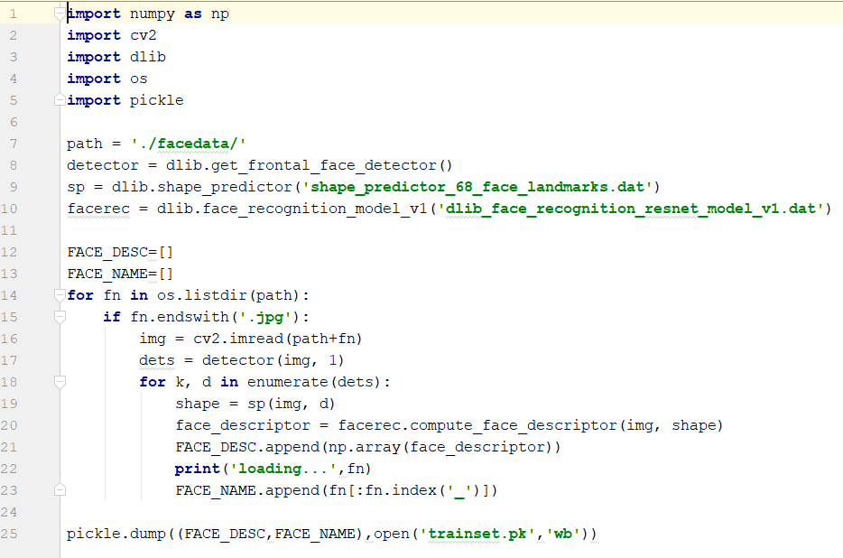
Appendix II – trainpicture.py

